Slide 1

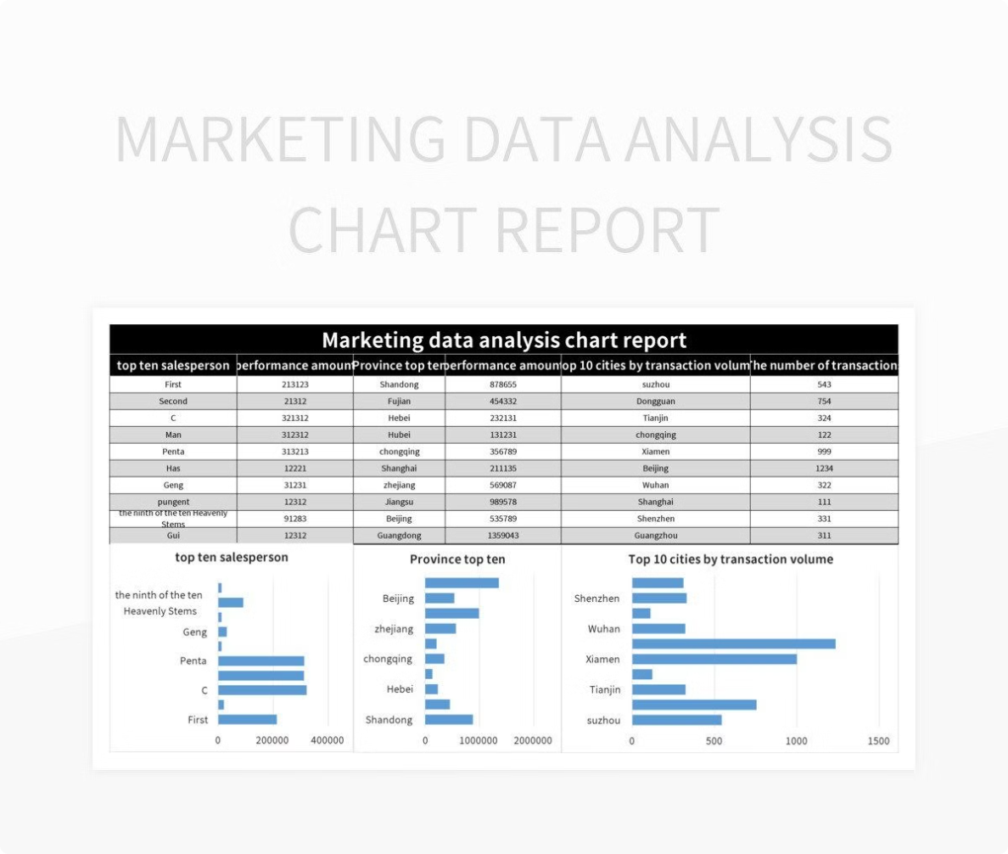

The Power of Data in Digital Marketing
In the dynamic world of digital marketing, navigating the vast ocean of data is paramount. Effective reporting and data visualization are not just tools, they're the compass guiding you toward successful campaigns. It's no longer enough to just launch campaigns and hope for the best. Today's marketers need to understand the nuances of their audiences and tailor their strategies based on concrete insights. This presentation will delve into the world of data-driven decision-making, showcasing its transformative power for your digital marketing efforts.
by Shreyas R A

Slide 2

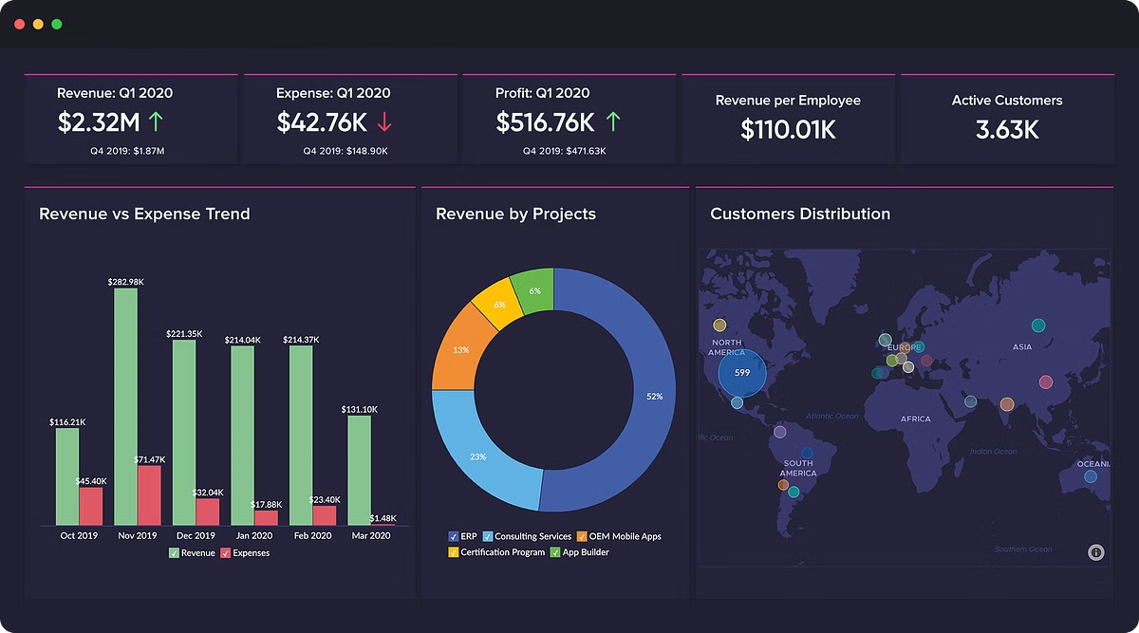
Data-Driven Decision Making: The Key to Success
1
Increased Efficiency
2
Enhanced Understanding of Audience
Data-driven decision making enables you to optimize every aspect of your marketing campaigns. By analyzing data, you can identify what's working well and double down on those strategies, while eliminating ineffective elements. This process not only saves time but also maximizes your return on investment.
Data provides a deep understanding of your target audience. You can uncover their preferences, behaviors, and pain points, allowing you to create highly targeted campaigns that resonate with them. This personalized approach leads to greater engagement and conversion rates.
3
Improved Campaign Performance
4
Informed Strategy Development
Data-driven insights allow you to measure the success of your campaigns in real-time. You can track metrics like click-through rates, conversion rates, and return on investment (ROI), making adjustments as needed to ensure optimal performance. This iterative approach guarantees continuous improvement.
Data empowers you to create robust marketing strategies that are grounded in reality, not assumptions. You can identify trends, analyze competitor data, and predict future market behavior, making informed decisions that drive growth. Data becomes the foundation for all your marketing activities.

Slide 3

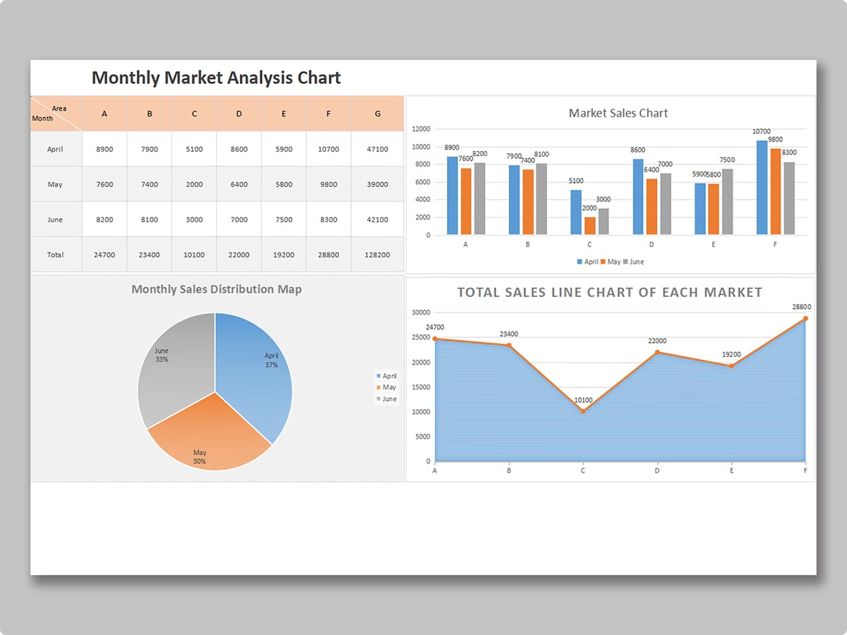
Key Metrics and KPIs for Digital Marketing Campaigns
Metric
Description
Importance
Website Traffic
Number of visitors to your website.
Indicates overall reach and audience engagement.
Bounce Rate
Percentage of visitors who leave your website after viewing only one page.
Measures user experience and content relevance.
Conversion Rate
Percentage of visitors who complete a desired action, such as a purchase or sign-up.
Reflects the effectiveness of your marketing efforts in driving conversions.
Return on Investment (ROI)
Measure of profit generated from marketing investments.
Evaluates the effectiveness of your campaigns in generating a return.

Slide 4
Effective Data Visualization Techniques
Charts and Graphs
Heat Maps
Infographics
Charts like bar graphs, line graphs, and pie charts are versatile for visualizing data trends. They're effective for presenting numerical data, highlighting comparisons, and showcasing changes over time.
Heat maps use color gradients to represent data density. They're useful for highlighting areas of high or low activity, such as user engagement on a webpage or geographical trends.
Infographics combine visual elements with textual information to present data in a compelling and easy-to-understand manner. They're ideal for summarizing complex data and making it visually appealing.

Slide 5


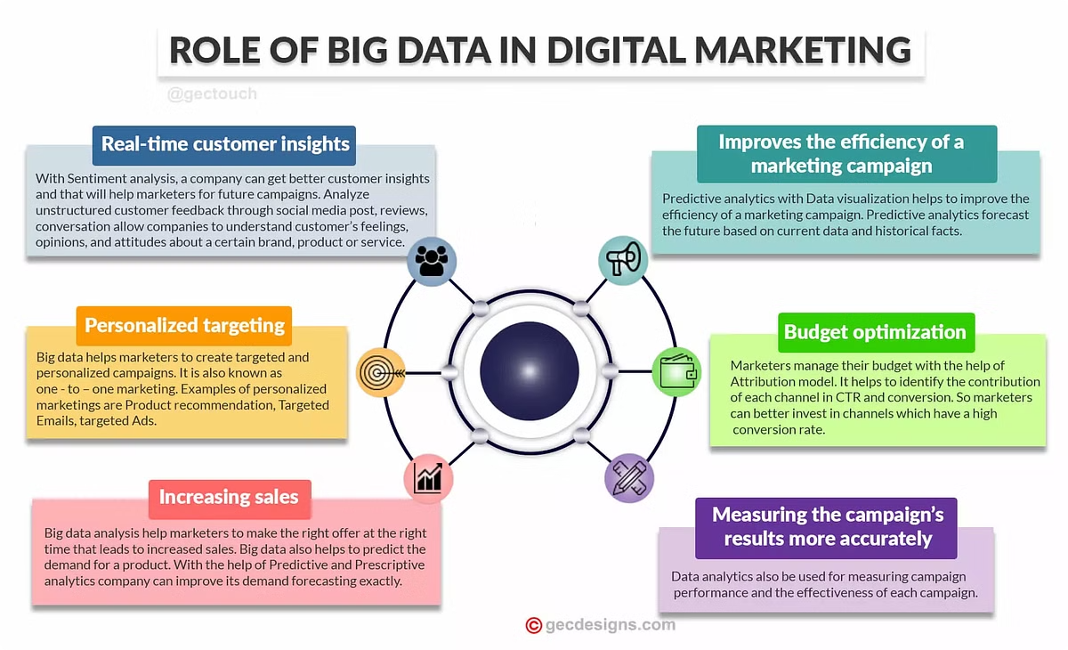


Leveraging Data Insights to Optimize Marketing Strategies
Data Analysis
Start by meticulously analyzing your data. Identify patterns, trends, and anomalies to gain insights into what's working and what's not. Use this information to inform your decision-making.
Strategy Adjustment
Based on your data analysis, adjust your marketing strategies. Focus on areas that are showing positive results and optimize those campaigns. Eliminate or rework strategies that aren't performing well.
Iterative Optimization
Continuously monitor and analyze your data. Make ongoing adjustments to your strategies based on the latest insights. This iterative process ensures that your campaigns remain effective and aligned with your target audience.

Slide 6


Conclusion: The Competitive Advantage of Data-Driven Digital Marketing
In today's competitive digital landscape, embracing data-driven marketing is no longer a choice but a necessity. By leveraging data insights, you gain a significant competitive advantage. You can personalize your campaigns, optimize your resources, and make informed decisions that drive growth. As you continue to learn from your data and refine your strategies, you'll create a dynamic and sustainable digital marketing strategy that sets you apart from the competition.

